Slide 2
Absence of Copyright
This slideshow contains photos, diagrams, and information, some of which were attained through internet searches of public websites. The author of this presentation does not own the copyright on this information, so this slideshow is for personal use only—not for sale or profit. Please utilize it to seek the Lord and grow in your knowledge of His Word and ways.

Slide 3
First Read-through

Slide 4
First Read-through

Slide 5
First Read-through

Slide 6
First Read-through
Notes:
James Smith first read:
Revelation 5 things God spoke to me in reading today
Revelation: 1) Those in Christ are still weak in flesh needing to consistently repent and focus on Jesus Christ 2) Power only comes from God, and there is great power in prayer throughout time 3) Many will cling to self, sin, and created things over God no matter what 4) Judgement must happen for paradise to be, and those of hate or love will meet their fate from which they choose 5) Sin purged and final Eden - paradise will come. God is true to His Word which never changes James E. Smith May 13, 2020
Not as fast a reader as you 1 hour and 15 minutes without stopping.

Slide 7
First Read-through
James Smith
Mike Pope
Email me your questions or observations at
stanfike@gmail.com
Notes:
James Smith first read:
Revelation 5 things God spoke to me in reading today
Revelation: 1) Those in Christ are still weak in flesh needing to consistently repent and focus on Jesus Christ 2) Power only comes from God, and there is great power in prayer throughout time 3) Many will cling to self, sin, and created things over God no matter what 4) Judgement must happen for paradise to be, and those of hate or love will meet their fate from which they choose 5) Sin purged and final Eden - paradise will come. God is true to His Word which never changes James E. Smith May 13, 2020
Not as fast a reader as you 1 hour and 15 minutes without stopping.
-------------------------------
Good afternoon Stan,
I'm accepting the offer of asking questions about the Book of Revelation. I'm not as fast as you at reading but I'm almost through the book.
A couple of things jumped out at me.
Could you comment on whether the descriptions in Revelation are literal or figurative? I understand the lampstands are the 7 churches and the stars in his right hand are the angels of the churches. But what about the first beast? What is the beast with 10 horns and 7 heads, with 10 diadems on its horns and blasphemous names on its heads? And the different colored horses? And the mouths like a lion and feet of a bear? Surely all of this is symbolic, right? I look forward to you breaking all this down for us.
Mike Pope

Slide 8
Purpose of Revelation
Revelation Completes the Gospel …
Devotional By Michael Youssef, Ph.D.
Revelation completes our understanding of God’s purpose for history and for our future.
Revelation shows us the danger of compromise and the ultimate destruction of Satan and those who reject Christ.
Revelation gives us an awe-inspiring portrait of the glorified, soon-coming King Jesus.
Notes:
Revelation Completes the Gospel
By Michael Youssef, Ph.D.
The word revelation has an important meaning: the manifestation or unveiling of something that has been hidden. In other words, the book of Revelation is the unveiling of God’s plan for the future.
God revealed this plan to John when he was in his 90s, exiled to the island of Patmos. Through John’s exile, God gifted John and His people with the most powerful heavenly vision for all of eternity: the Revelation of Jesus Christ. This vision completes the Gospel, giving hope to, sternly warning, and deeply comforting all those who trust in Jesus. As you read it, remember these three purposes of Revelation:
Revelation completes our understanding of God’s purpose for history and for our future. Revelation assures us that, while the world may look out of control, it’s not out of the control of God; He holds His children in His loving hand. From Genesis to Revelation, God has a plan, and Jesus is at the center of it all.
Revelation shows us the danger of compromise and the ultimate destruction of Satan and those who reject Christ. In Revelation we see that God has secured the victory, and judgment will come at the end times. Therefore we must not compromise, but stand firm against the spirit of this age, who says we can have salvation without the Savior, power without prayer, spirituality without the Holy Spirit, and morality without the Bible.
Revelation gives us an awe-inspiring portrait of the glorified, soon-coming King Jesus. John’s vision completes the Gospel of salvation -- past, present, and future. For in Revelation we see Jesus no longer hanging on a cross, but glorified in white and gold, with hair white as wool, with eyes that blaze with fire, with a voice like rushing waters (see Revelation 1:13-15). We see Jesus as the Alpha and the Omega, the beginning and the end (22:13).

Slide 9
Revelation – Introduction – Revelation 1:1-3
The Revelation of Jesus Christ
1 The Revelation of Jesus Christ, which God gave Him to show to His bond-servants, the things which must soon take place; and He sent and communicated it by His angel to His bond-servant John, ² who testified to the word of God and to the testimony of Jesus Christ, even to all that he saw. ³ Blessed is he who reads and those who hear the words of the prophecy, and heed the things which are written in it; for the time is near.
Notes:
Revelation Completes the Gospel
By Michael Youssef, Ph.D.
The word revelation has an important meaning: the manifestation or unveiling of something that has been hidden. In other words, the book of Revelation is the unveiling of God’s plan for the future.
God revealed this plan to John when he was in his 90s, exiled to the island of Patmos. Through John’s exile, God gifted John and His people with the most powerful heavenly vision for all of eternity: the Revelation of Jesus Christ. This vision completes the Gospel, giving hope to, sternly warning, and deeply comforting all those who trust in Jesus. As you read it, remember these three purposes of Revelation:
Revelation completes our understanding of God’s purpose for history and for our future. Revelation assures us that, while the world may look out of control, it’s not out of the control of God; He holds His children in His loving hand. From Genesis to Revelation, God has a plan, and Jesus is at the center of it all.
Revelation shows us the danger of compromise and the ultimate destruction of Satan and those who reject Christ. In Revelation we see that God has secured the victory, and judgment will come at the end times. Therefore we must not compromise, but stand firm against the spirit of this age, who says we can have salvation without the Savior, power without prayer, spirituality without the Holy Spirit, and morality without the Bible.
Revelation gives us an awe-inspiring portrait of the glorified, soon-coming King Jesus. John’s vision completes the Gospel of salvation -- past, present, and future. For in Revelation we see Jesus no longer hanging on a cross, but glorified in white and gold, with hair white as wool, with eyes that blaze with fire, with a voice like rushing waters (see Revelation 1:13-15). We see Jesus as the Alpha and the Omega, the beginning and the end (22:13).

Slide 10
1:1
“revelation” = “apocalypse” = “unveiling what’s hidden”

Slide 11
1:1
“revelation” = “apocalypse” = “unveiling”
“of Jesus Christ” = subjective or objective

Slide 12
1:1
“revelation” = “apocalypse” = “unveiling”
“of Jesus Christ” = subjective or objective
“from Jesus Christ” or “about Jesus Christ”

Slide 13
1:1
“revelation” = “apocalypse” = “unveiling”
“of Jesus Christ” = subjective or objective
“from Jesus Christ” or “about Jesus Christ”
to show His bond servants = believers then or always?

Slide 14
1:1
“revelation” = “apocalypse” = “unveiling”
“of Jesus Christ” = subjective or objective
“from Jesus Christ” or “about Jesus Christ”
to show His bond servants = believers then or always?
must soon take place = necessity

Slide 15
1:1
“revelation” = “apocalypse” = “hidden”
“of Jesus Christ” = subjective or objective
“from Jesus Christ” or “about Jesus Christ”
to show His bond servants = believers then or always?
must soon take place = necessity
by His angel to John = the “Apostle whom Jesus loved”

Slide 16
1:2
² who testified to the word of God and to the testimony of Jesus Christ, even to all that he saw.

Slide 17
1:2
² who testified to the word of God and to the testimony of Jesus Christ, even to all that he saw.
μαρτυρίαν = martyrian = testimony

Slide 18
1:2
² who testified to the word of God and to the testimony of Jesus Christ, even to all that he saw.
μαρτυρίαν = martyrian = testimony
λόγον = logon (logos) = Word

Slide 19
1:3
³ Blessed is he who reads and those who hear the words of the prophecy, and heed the things which are written in it; for the time is near.

Slide 20
1:3
³ Blessed is he who reads and those who hear the words of the prophecy, and heed the things which are written in it; for the time is near.
Blessed = Read, Hear, Heed
One of the only books in the Bible that promise a blessing just for reading, hearing and heeding it.
Notes:
Kris Langham devotional on YouVersion app
Revelation is an instruction to His servants. That means any believer can benefit from the message of Revelation. God wants to give a blessing to His servants, and the word He uses for ‘blessed’ is makarios which means happy. We all want to have a happy life. God tells His servants three things they need to do to be blessed, or happy:
Read this letter
Hear (or understand) this letter
Keep (or do) the things written in this letter
The purpose of the book of Revelation is for servants to learn how to be blessed by reading what’s in this prophecy, understanding it, then doing it. It’s a very simple book from that standpoint.
Do you think it would make sense for God to say we can be blessed by reading a prophetic word, then give us a letter in a language that can’t be read? Of course not, that would be silly. Is it any less absurd to consider that God would tell us we can be blessed by a prophetic word if we understand it, then give us a letter that was incomprehensible? Again, that would be unthinkable.
Perhaps the biggest key to understanding that Revelation is a simple book with a simple message is the next word: keep. Would it make sense for God to give us a prophetic word for us to keep, or do, then not give us anything to do? If God gave us a prophetic word so that we could read, understand, and keep or do, then it must be readable, understandable, and doable.
Revelation has many predictions about the future, but we cannot do in the future. We can only do in the present. The main purpose of Revelation is not to give us a future-events puzzle to untangle. Rather, the primary purpose is to show us what to do now, in the present. As with anything, making a decision to do begins with hearing (or thinking), coming to an understanding (making a plan) then acting.
Kris Langham devotional

Slide 21
1:3
³ Blessed is he who reads and those who hear the words of the prophecy, and heed the things which are written in it; for the time is near.
Blessed = Read, Hear, Heed
One of the only books in the Bible that promise a blessing just for reading, hearing and heeding it.
One of the only books that carries a curse as well…

Slide 22
Revelation 22:18-21
¹⁸ I testify to everyone who hears the words of the prophecy of this book: if anyone adds to them, God will add to him the plagues which are written in this book; ¹⁹ and if anyone takes away from the words of the book of this prophecy, God will take away his part from the tree of life and from the holy city, which are written in this book.
²⁰ He who testifies to these things says, “Yes, I am coming quickly.” Amen. Come, Lord Jesus.
²¹ The grace of the Lord Jesus be with all. Amen.

Slide 23
Revelation 1:4-6
⁴ John to the seven churches that are in Asia: Grace to you and peace, from Him who is and who was and who is to come, and from the seven Spirits who are before His throne, ⁵ and from Jesus Christ, the faithful witness, the firstborn of the dead, and the ruler of the kings of the earth. To Him who loves us and released us from our sins by His blood— ⁶ and He has made us to be a kingdom, priests to His God and Father—to Him be the glory and the dominion forever and ever. Amen.

Slide 24
1:4
the seven churches that are in Asia:

Slide 26
1:4-5
Grace to you and peace, from Him who is and who was and who is to come, and from the seven Spirits who are before His throne, ⁵ and from Jesus Christ, the faithful witness, the firstborn of the dead, and the ruler of the kings of the earth.

Slide 27
1:4-5
Grace to you and peace, from Him who is and who was and who is to come, and from the seven Spirits who are before His throne, ⁵ and from Jesus Christ, the faithful witness, the firstborn of the dead, and the ruler of the kings of the earth.
Doctrine of the Trinity

Slide 28
1:4-5
Grace to you and peace, from Him who is and who was and who is to come, and from the seven Spirits who are before His throne, ⁵ and from Jesus Christ, the faithful witness, the firstborn of the dead, and the ruler of the kings of the earth.
Doctrine of the Trinity
Yahweh = “I Am” (is, was, will be)

Slide 29
1:4-5
Grace to you and peace, from Him who is and who was and who is to come, and from the seven Spirits who are before His throne, ⁵ and from Jesus Christ, the faithful witness, the firstborn of the dead, and the ruler of the kings of the earth.
Doctrine of the Trinity
Yahweh = “I Am” (is, was, is coming)
Seven Spirits = “seven-fold Spirit”

Slide 30
1:4-5
Grace to you and peace, from Him who is and who was and who is to come, and from the seven Spirits who are before His throne, ⁵ and from Jesus Christ, the faithful witness, the firstborn of the dead, and the ruler of the kings of the earth.
Doctrine of the Trinity
Yahweh = “I Am” (is, was, is coming)
Seven Spirits = “seven-fold Spirit”
“seven” = used 53 times in Revelation
Divine number of completion or perfection

Slide 31
1:4-5
Grace to you and peace, from Him who is and who was and who is to come, and from the seven Spirits who are before His throne, ⁵ and from Jesus Christ, the faithful witness, the firstborn of the dead, and the ruler of the kings of the earth.
Doctrine of the Trinity
Yahweh = “I Am” (is, was, is coming)
Seven Spirits = “seven-fold Spirit”
Jesus Christ =
The faithful witness
The firstborn of the dead
The ruler of the kings of the earth

Slide 32
1:5-6
⁵ and from Jesus Christ, the faithful witness, the firstborn of the dead, and the ruler of the kings of the earth. To Him (Jesus Christ) who loves us and released us from our sins by His blood—
Jesus Christ =
The faithful witness = Messiah, Teacher, Prophet
The firstborn of the dead = Risen Life-giver
The ruler of the kings of the earth = Lord, King
Loved us = Beloved Friend, Priest
Released us from our sins = Savior

Slide 33
1:6
⁶ and He has made us to be a kingdom, priests to His God and Father—to Him be the glory and the dominion forever and ever. Amen.
Kingdom
Priests

Slide 34
1:6
⁶ and He has made us to be a kingdom, priests to His God and Father—to Him be the glory and the dominion forever and ever. Amen.
Kingdom = Royal Privilege
Priests = Responsibility

Slide 35
Revelation 1:7
⁷ Behold, He is coming with the clouds, and every eye will see Him, even those who pierced Him; and all the tribes of the earth will mourn over Him. So it is to be. Amen.

Slide 36
Revelation 1:7
⁷ Behold, He is coming with the clouds, and every eye will see Him, even those who pierced Him; and all the tribes of the earth will mourn over Him. So it is to be. Amen.
We won’t miss the RETURN of Jesus!

Slide 37
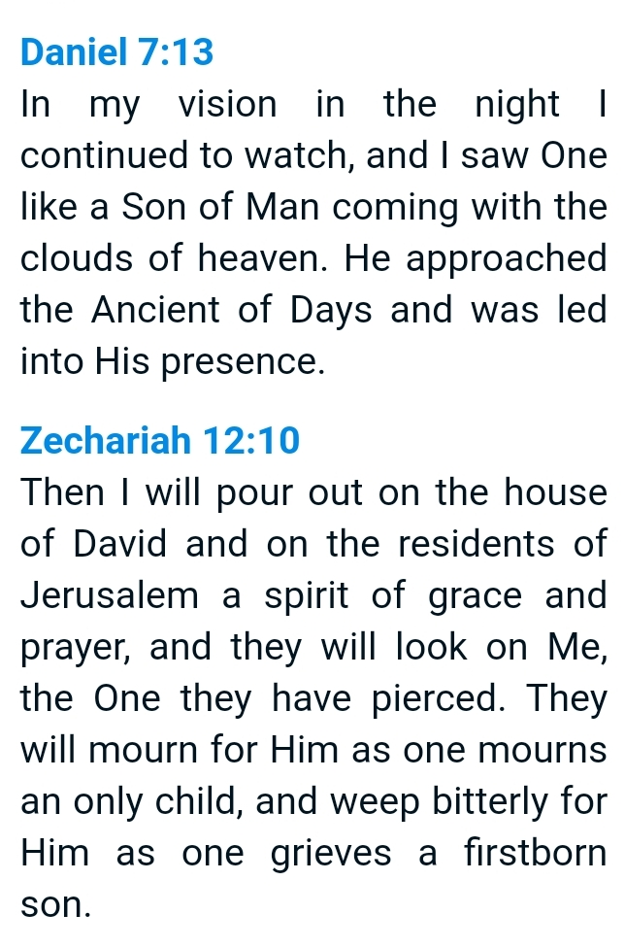
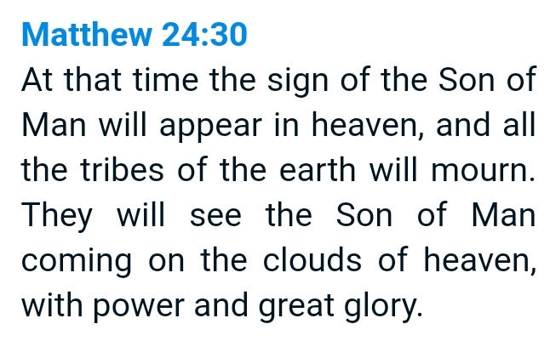
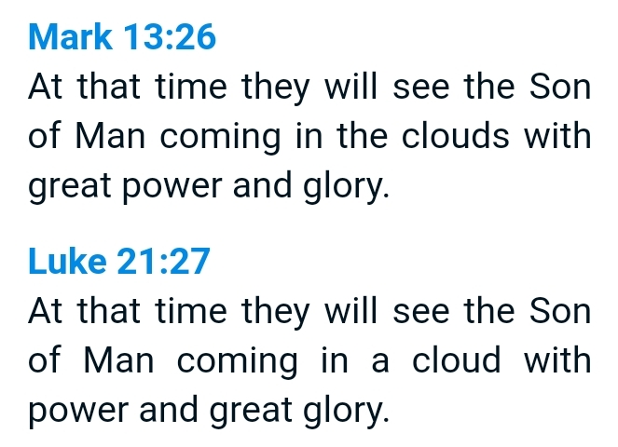
We won’t miss the return of Jesus!
https://biblehub.com/revelation/1-7.htm

